Slide 1
R and RStudio installation
R: https://cloud.r-project.org/
RStudio: https://posit.co/download/rstudio-desktop/
GitHub repo:
https://github.com/BioinfoHKUSurgery/Bioinfo-Workshop-2024

Slide 2
Omics data analysis
Paul, Clara, Vincent

Slide 3
Course outline
Session 1 (8th May): Omics intro & Bulk RNA-seq data analysis
Introduction to Omics data analysis
Introduction to RNA-seq and transcriptomics
Quality Control and Data Preprocessing
Read Alignment and Transcriptome Assembly
Gene Expression Quantification
Differential Gene Expression Analysis
Visualization and Interpretation of Results
Advanced Topics in RNA-seq Analysis
Case Studies and Practical Session
Session 2: Single cell RNA-seq data analysis
Introduction to Single-Cell RNA-seq
Preprocessing and Quality Control
Read mapping and quantification
Normalization and batch effect correction
Dimensionality Reduction and Visualization
Clustering, Cell Type Identification & Differential Expression Analysis
Trajectory Analysis and Pseudotime Inference
Integration with other Omics data
Emerging Technologies and Future Directions
Case Studies and Practical Session

Slide 4
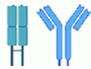
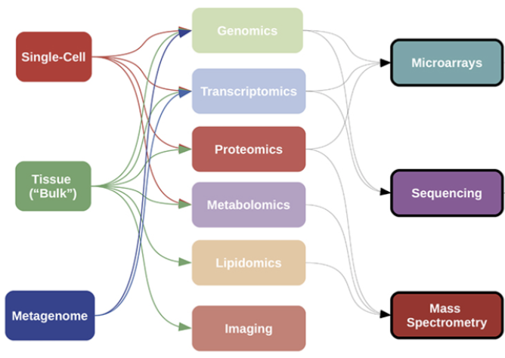
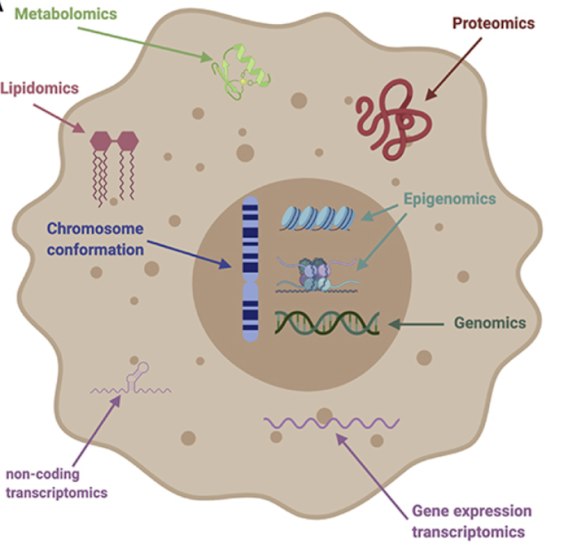
Omics data analysis
Omics refers to the large-scale study of biological molecules such as genes, transcripts, proteins, and metabolites.
Omics technologies allow researchers to profile the entire set of molecules in an unbiased way though rapid generation of high-throughput data
Aims to provide an global view of cellular activity at multiple levels
Immunomics

Slide 5
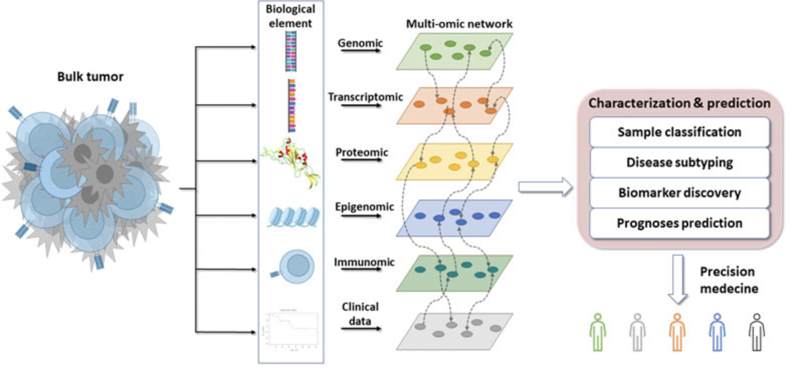
Importance of Omics Data Analysis
Allows us to extract meaningful insights from large and complex datasets.
Enables identification of biomarkers, drug targets, and potential therapeutic interventions.
Facilitates understanding of biological processes, disease mechanisms, disease subtypes and personalized medicine.
Disease sample

Slide 6
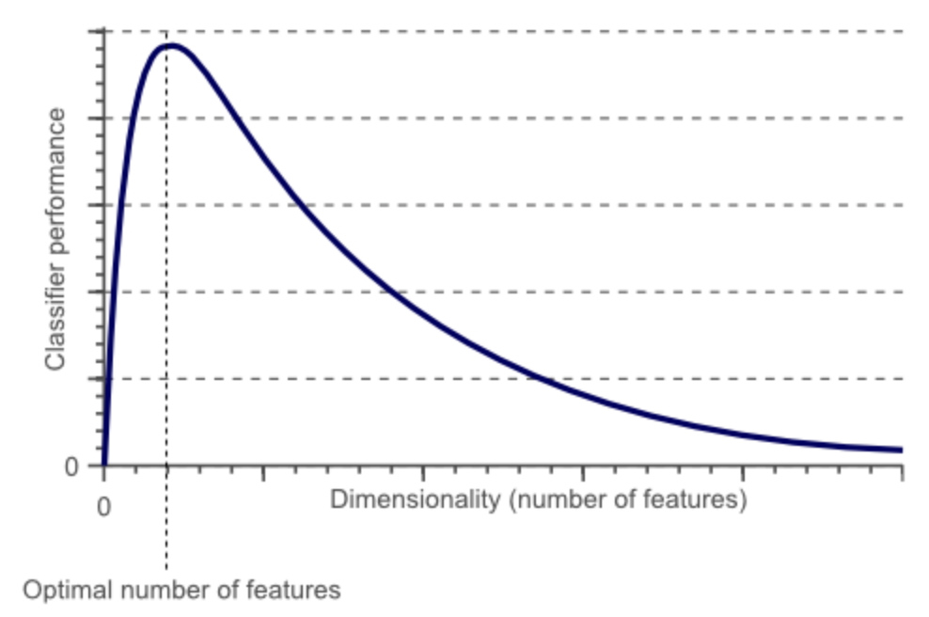
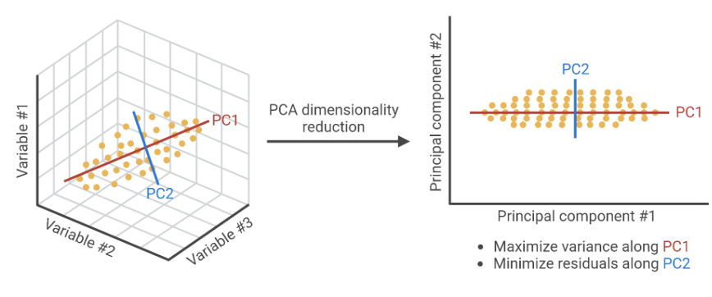
Challenges in Omics Data Analysis
”Curse of dimensionality”
The scale and complexity of Omics data presents a number of challenges:
Data pre-processing and quality control.
Statistical analysis and inference.
Integration and interpretation of multi-omics data.
Bioinformatics tools can help overcome these:
Data pre-processing and quality control
Provide algorithms, databases, and visualization tools for data analysis.
Statistical and machine learning analysis to identify significant differences and patterns in the data and extract meaningful insights.
Integration of multi-Omics data using correlation-based methods, network-based methods, and machine learning.

Slide 7
Introduction to RNA-seq
What is RNA-seq?
RNA-seq is a high-throughput sequencing technique used to study gene expression across the entire transcriptome
Bulk RNA-seq provides information on the average expression of genes across a population of cells, rather than on a single-cell level.
Why use RNA-seq?
RNA-seq offers several advantages over traditional methods like microarrays
Covers an extremely broad dynamic range
Provides sensitive, accurate measurement of gene expression
Captures both known and novel features; does not require predesigned probes
Generates both qualitative and quantitative data
Reveals the full transcriptome, not just a few selected transcripts

Slide 8
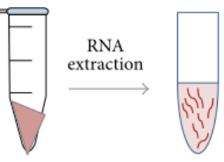

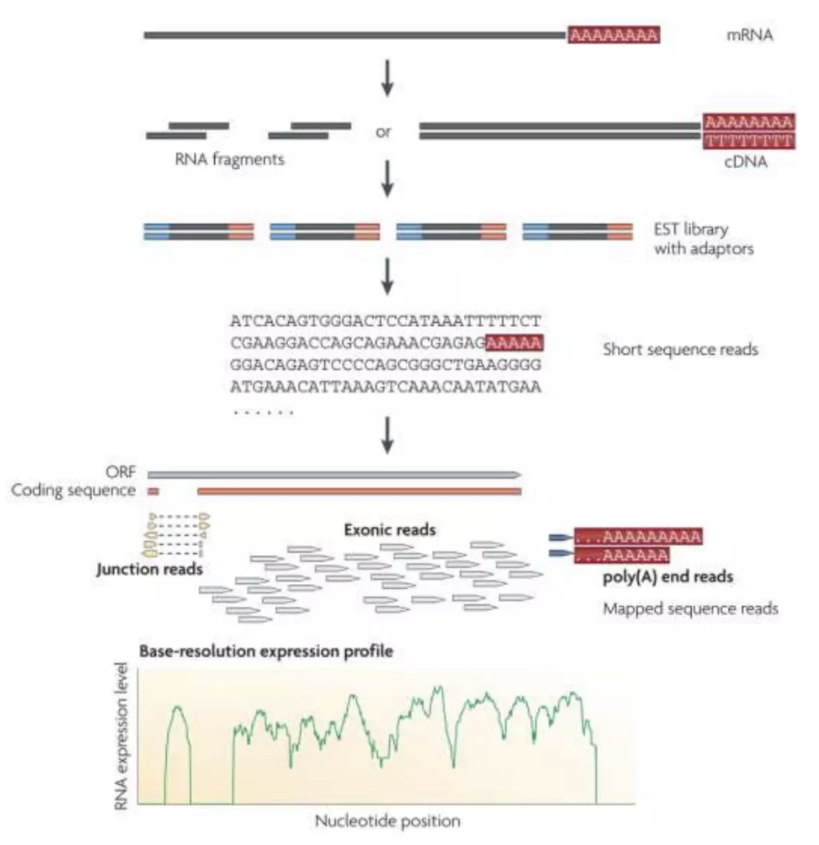
RNA-seq general workflow
Workflow of RNA-seq
1. RNA Isolation: Total RNA is extracted from cells or tissues.
2. Library Preparation: RNA is converted into cDNA libraries, which are sequenced.
3. Sequencing: High-throughput sequencing generates millions of short reads.
4. Data Analysis: Bioinformatics tools are used to process and map the sequencing reads to the reference genome or transcriptome sequence
Things to consider
paired-end RNA-seq or single-end RNA-seq?
Read length?: 50-150 bp typical (Illumina)
Strand specific ?
Total RNA or mRNA?

Slide 9



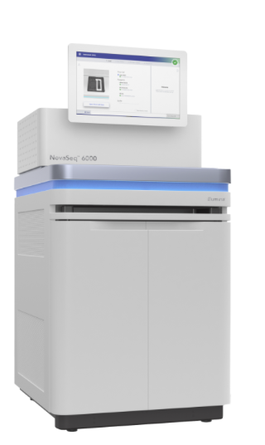
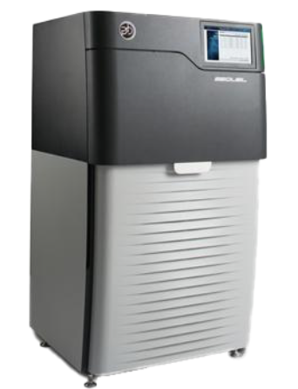
RNA-seq platforms: which one to choose?
Long-read sequencing technology (up to 100Kbp)
full-length transcript sequencing, enabling isoform-level analysis and detection of alternative splicing.
Can detect RNA modifications and sequence across difficult-to-amplify regions.
Requires high input RNA due to the high cost per sample and lower throughput compared to Illumina.
Suitable for studying complex transcriptomes, gene fusion events in diseases (e.g. cancer)
High-throughput, widely used technology
Generates short-read sequencing data with high accuracy and low error rates
Suitable for differential gene expression analysis and transcript quantification
Cost-effective for large-scale experiments, but requires high sequencing depth for isoform-level analysis
Compatible with a variety of disease sample types, including degraded or low-quality RNA
Wide range of applications, more software tools available.
Pacbio Sequel
Novaseq 6000
Popular tools for Pacbio data
Popular tools for illumina data
TAMA
Iso-Seq
FLAIR
GMAP
SQANTI
BWA
Hisat2
STAR
Trimmomatic
DESeq2
edgeR

Slide 10


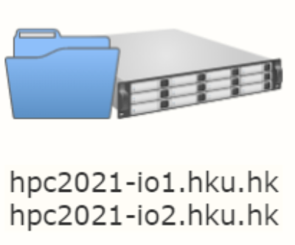


RNA-seq analysis pipeline for illumina data
Data Pre-processing
FastQC
Timmomatic
Web-based platforms
1a
Read Mapping
BWA
HISAT2
STAR
OR
1b
High performance computing cluster
Post-processing / Quantification
Samtools
Picard
HTSeq
Gene Regulatory Network analysis
SCENIC
GENIE3
GNET2
Dimension Reduction & Clustering
prcomp
Rtsne
pheatmap
mixOmics
DGE analysis/
Pathway analysis
DESeq2
edgeR
GSEA
2
RStudio on local machine

Slide 11
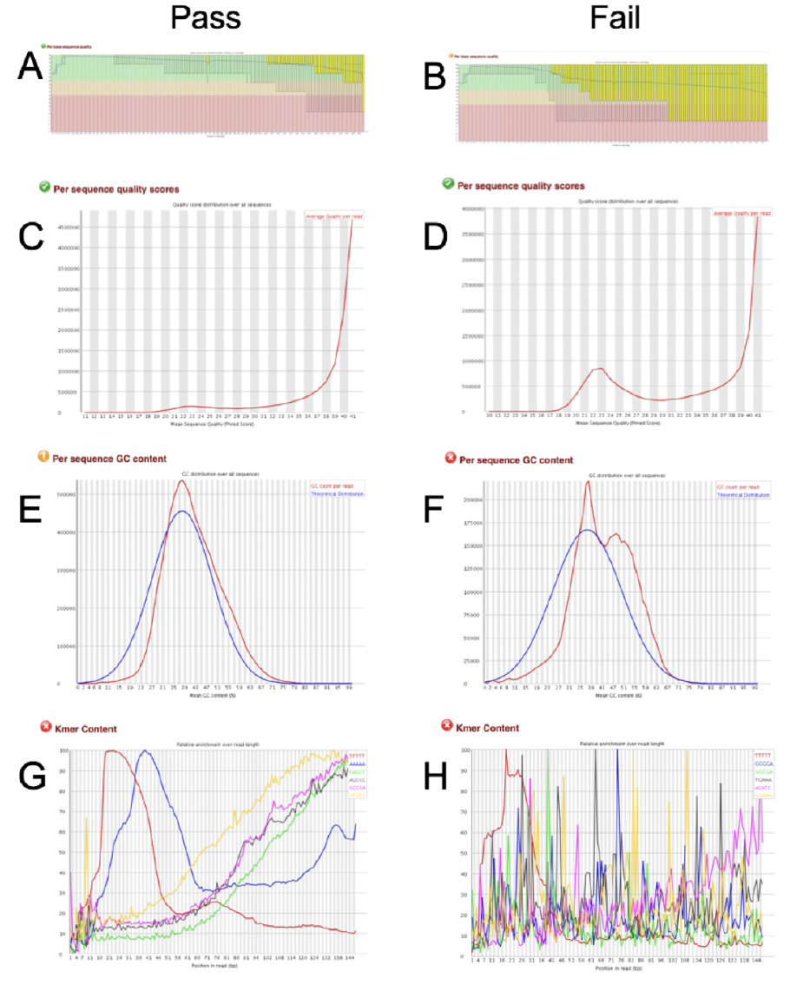



QC & data preprocessing
Per base sequence quality
Per base sequence quality
Raw RNA-seq data usually in FASTQ format
Can be used directly as input to FASTQC tool to inspect read quality.
FASTQC can flag up any adapter contamination, low-quality bases, or overrepresented sequences.
Adapter contamination and low-quality bases can be removed using tools like Trimmomatic or Cutadapt. Improves the accuracy of downstream analyses.
Per sequence quality scores
Per sequence quality scores
Per sequence GC content
Per sequence GC content
Kmer content
Kmer content

Slide 12
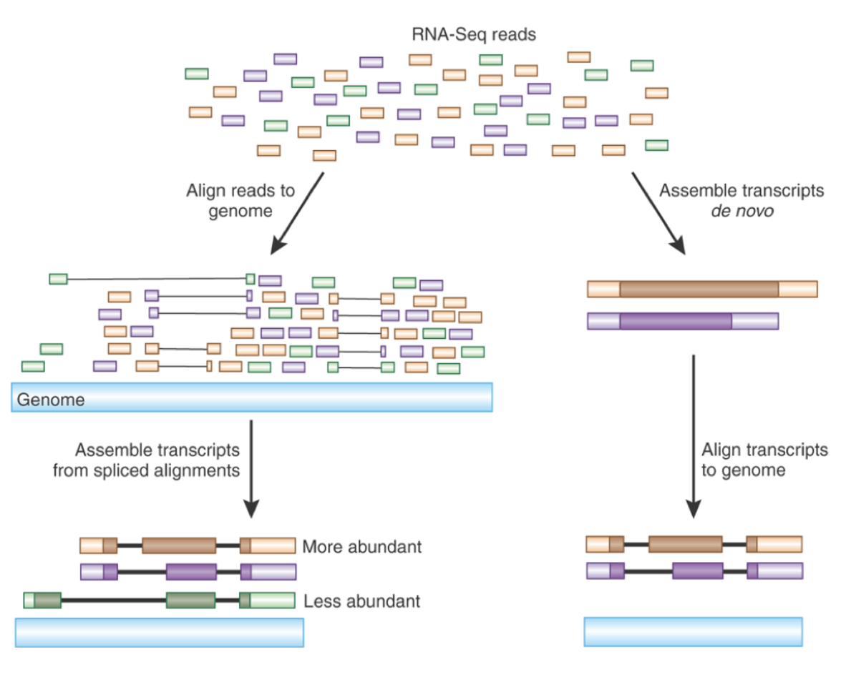
Read alignment & assembly
The reference genome or transcriptome is first indexed to enable fast and efficient read alignment.
Reads are aligned to a reference genome or transcriptome to determine their genomic or transcriptomic origin, using alignment tools like HISAT2, STAR, or TopHat2
GTF/GFF files containing splice sites must be provided map reads spanning introns.
Outputs SAM files for storing the alignment information such as mapping quality scores, Indels and mismatches etc.
Alternatively, de novo transcript assembly can reconstruct transcripts from RNA-seq reads without a reference genome or transcriptome using tools such as Trinity.
Useful when samples may contain genomic rearrangements (e.g. cancer) or for HLA typing.

Slide 13
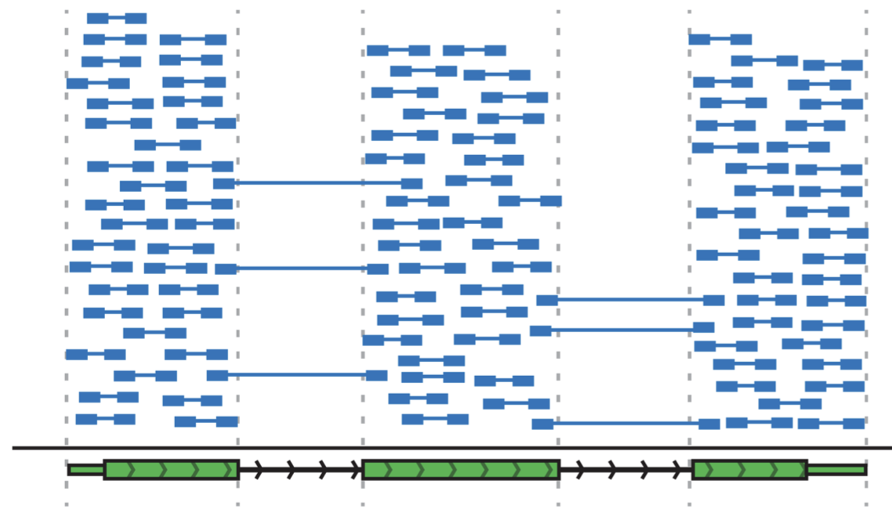
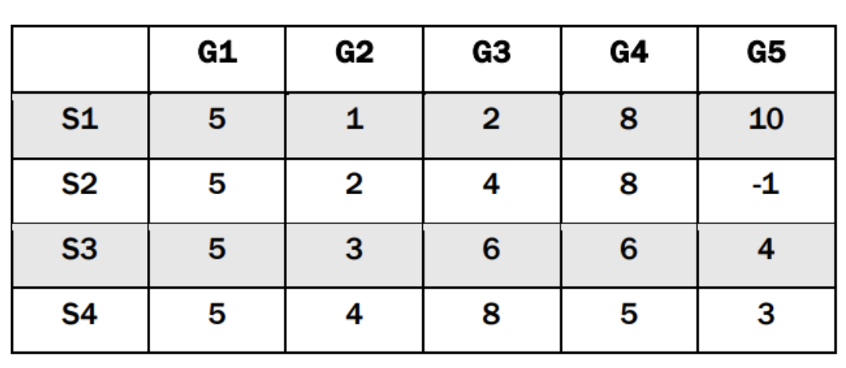
Expression quantification: alignment based
Alignment-based quantification is the process of estimating the abundance of transcripts from RNA-seq reads aligned to the geome using tools such HISAT2, STAR, or TopHat2.
Bioinformatics software such as Samtools are used to sort and index SAM files
Then tools such HTSeq can be used to count the number of reads that map to each gene.
Reads mapping to multiple genes may be exluded.
htseq-count
Count Matrix

Slide 14
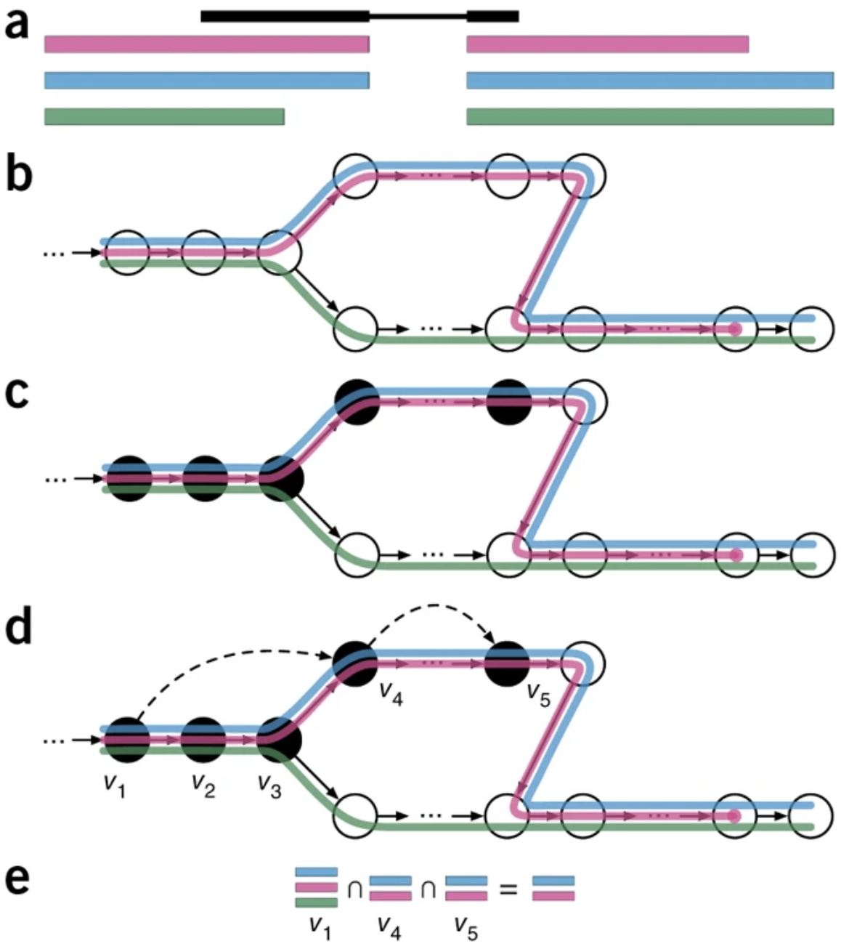
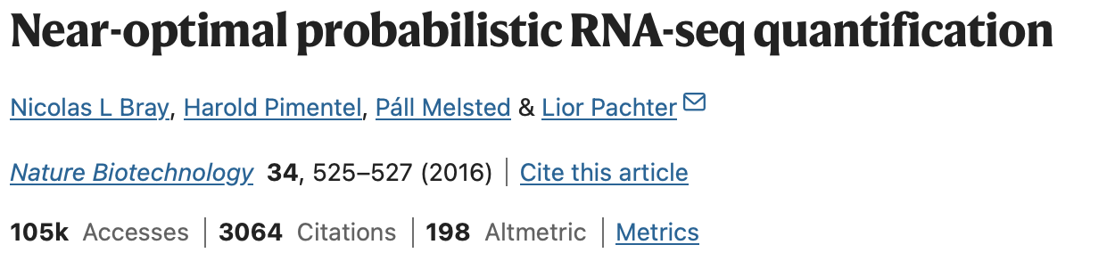
Expression quantification: pseudoalignment
Pseudoalignment methods involve quantifying transcript abundance without aligning the reads to a reference genome or transcriptome.
Examples of alignment-free methods include Kallisto, Sailfish, and Salmon.
These methods rely on the analysis of k-mers (short subsequences of the reads) to estimate transcript abundance.
Instead of aligning the full read sequences to the transcriptome, Kallisto maps the observed k-mers in RNA-seq reads to their corresponding positions in the k-mer index.
Kallisto uses the pseudoalignment information to estimate the compatibility of each read with each transcript. A statistical model is then used to calculate transcripts per million (TPM).

Slide 15
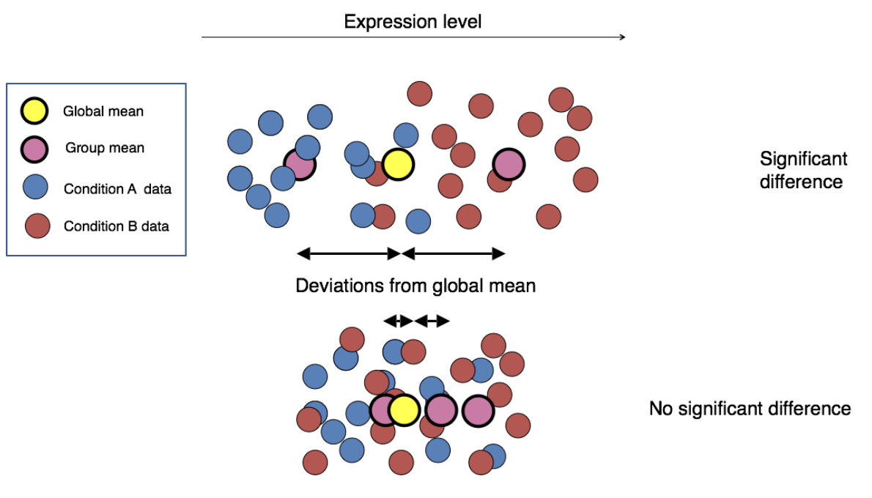
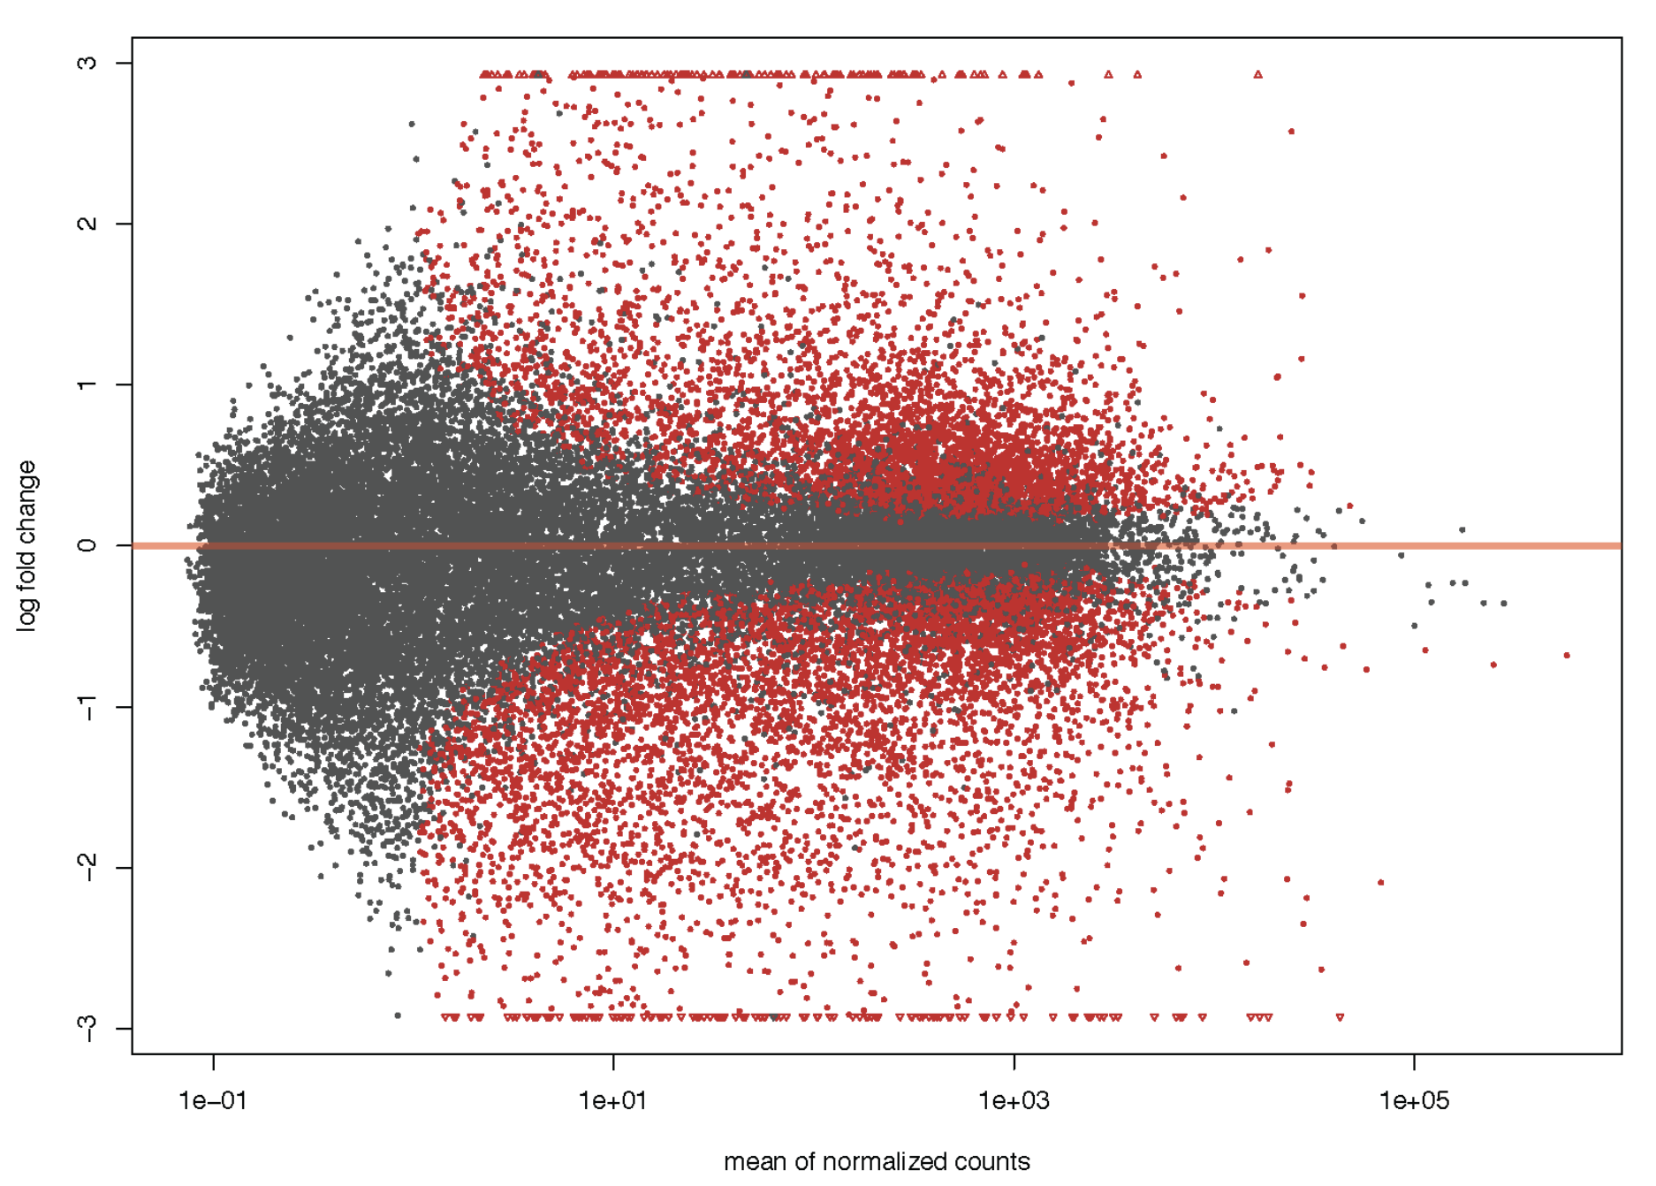
Differential Expression (DE) Analysis
Once the expression levels are quantified, the next step is to identify genes or transcripts that are differentially expressed between different conditions or groups.
This involves statistical analysis to compare the expression levels between the samples, while accounting for various sources of variability and bias, such as sequencing depth, sample size, and biological variability.
Some commonly used tools for differential expression analysis are DESeq2, edgeR, and limma.
DESeq2 uses a negative binomial model to account for overdispersion in RNA-seq count data, enabling more accurate estimation of fold changes and p-values.

Slide 16
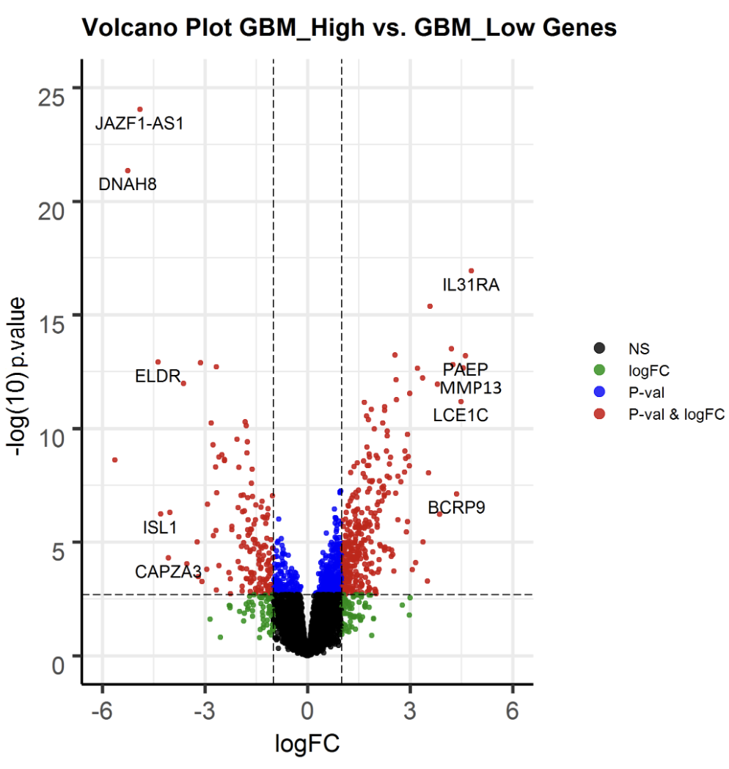
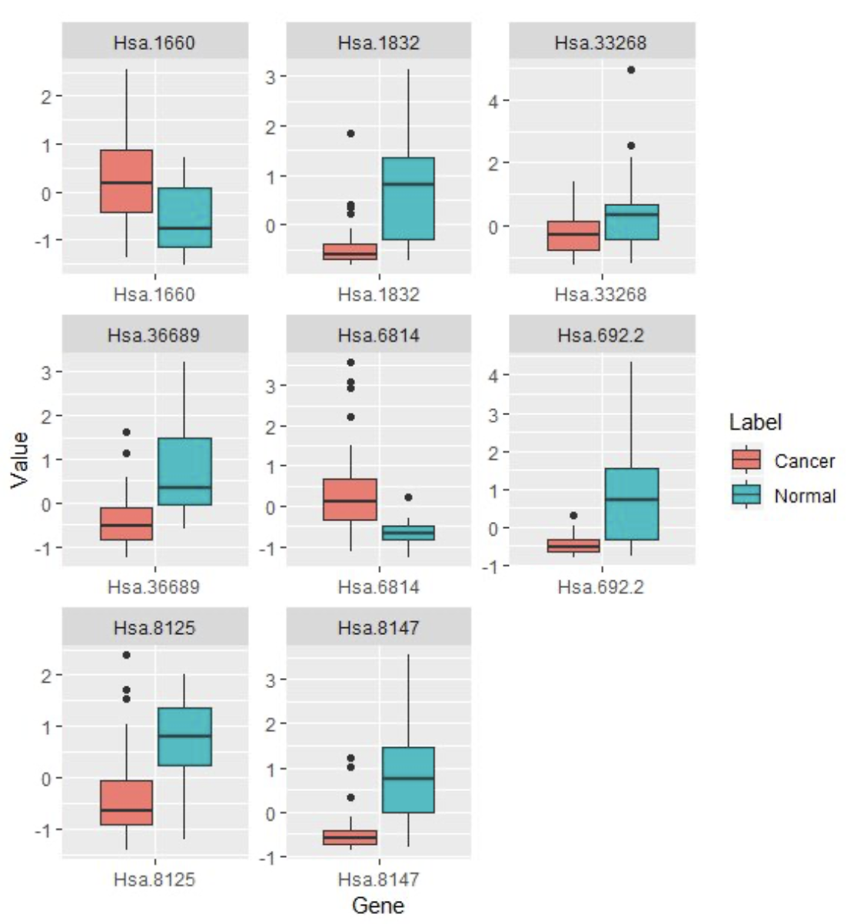
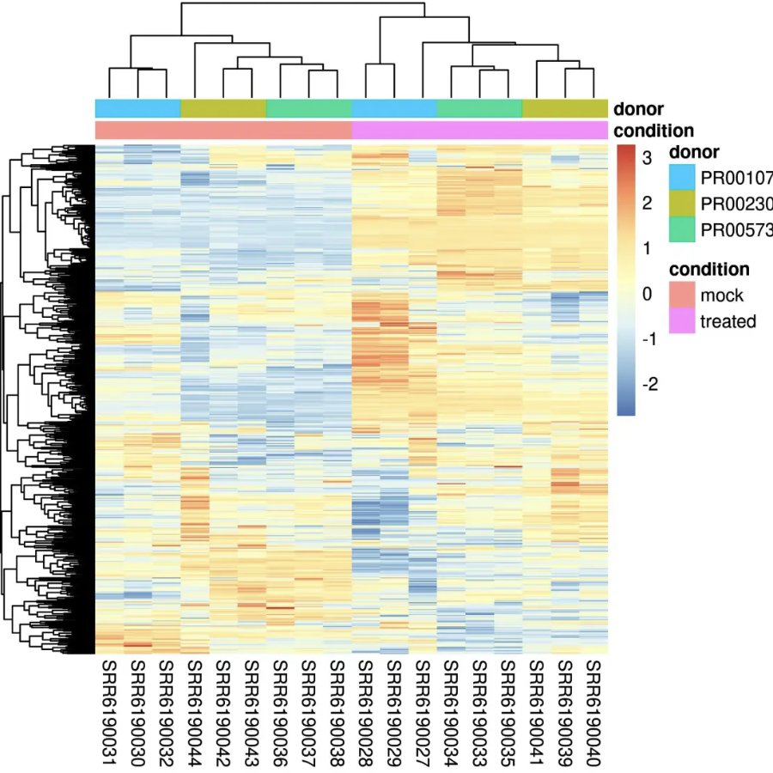
Visualizing DE results
ggplot2 - volcano plot
ggplot2 – boxplots
Popular methods to visualize differential expression results in R:
Volcano Plots
Boxplots
Heatmaps
MA plots
Pheatmap - heatmap
DESeq2 - MA plot

Slide 17
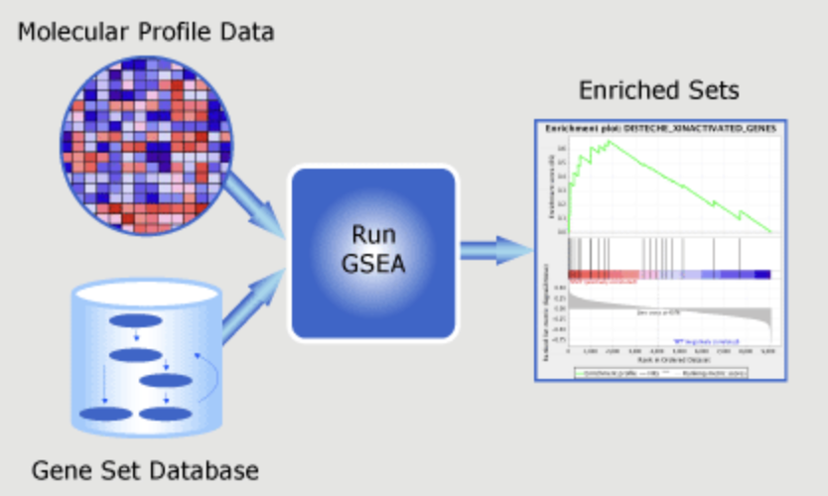
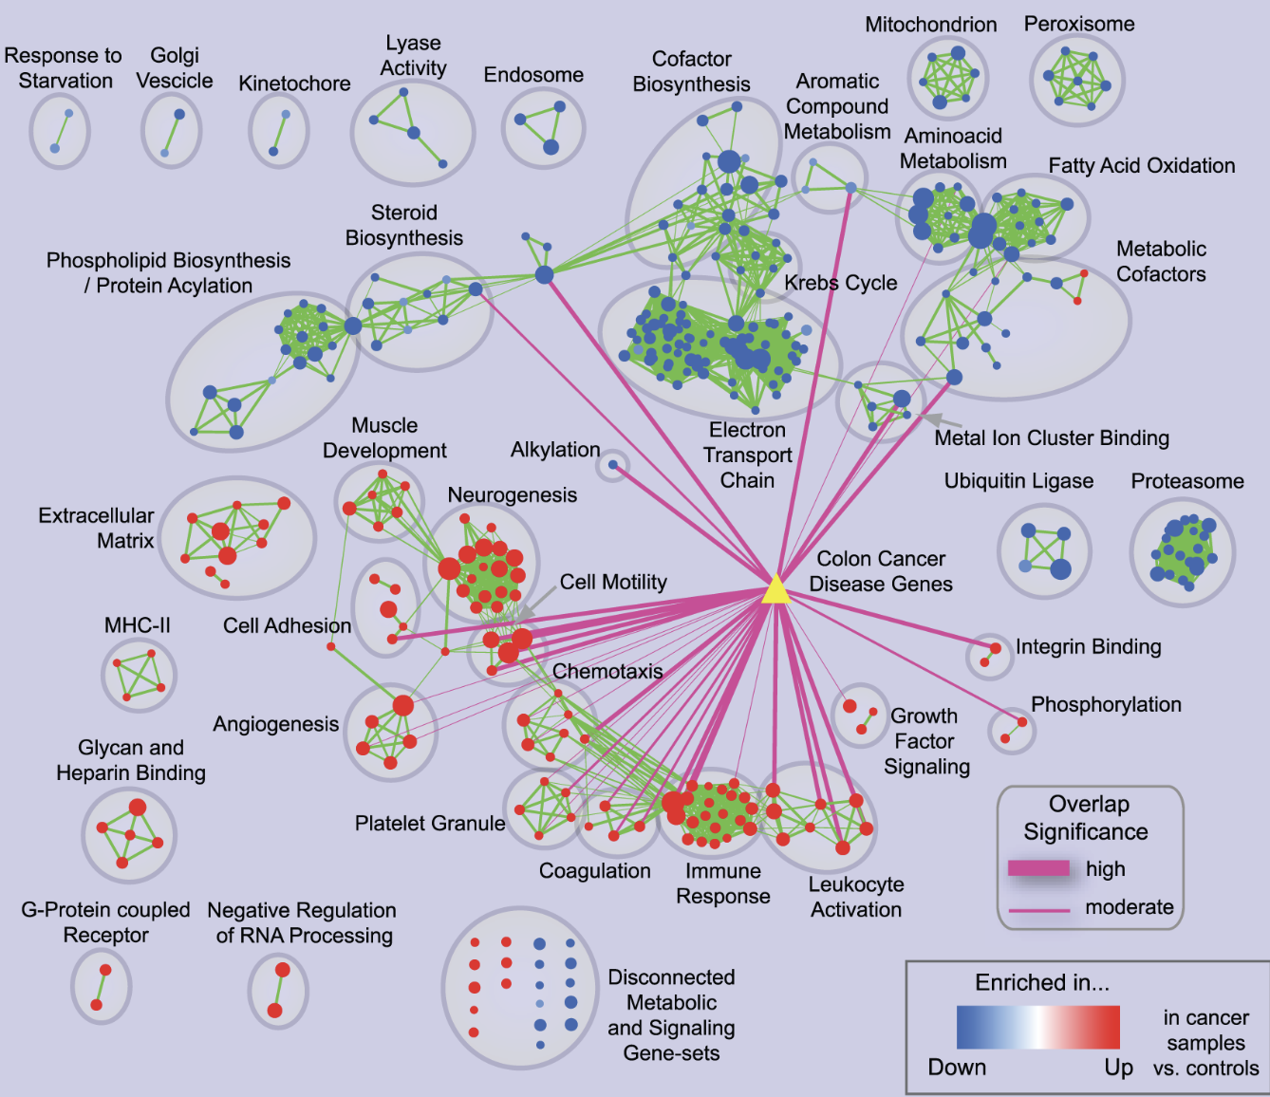
Pathway analysis
Gene Set Enrichment Analysis (GSEA): a computational method that determines whether an a priori defined set of genes shows significant, concordant differences between two biological states (e.g. disease vs control).
The log2fc results and p-values from DESeq2/EdgeR can be used as input into GSEA
GSEA calculates enrichment score (ES) for each gene set, which measures the degree to which the members of the gene set are overrepresented at the top or bottom of the ranked list
Enriched pathways or GO terms can be displayed on Cytoscape using g:Profiler
R packages for GSEA include clusterProfiler and fGSEA
Gene set databases include Gene Ontology and KEGG.
Other methods for pathway analysis include clusterProfier, ReactomePA and GOstats

Slide 18
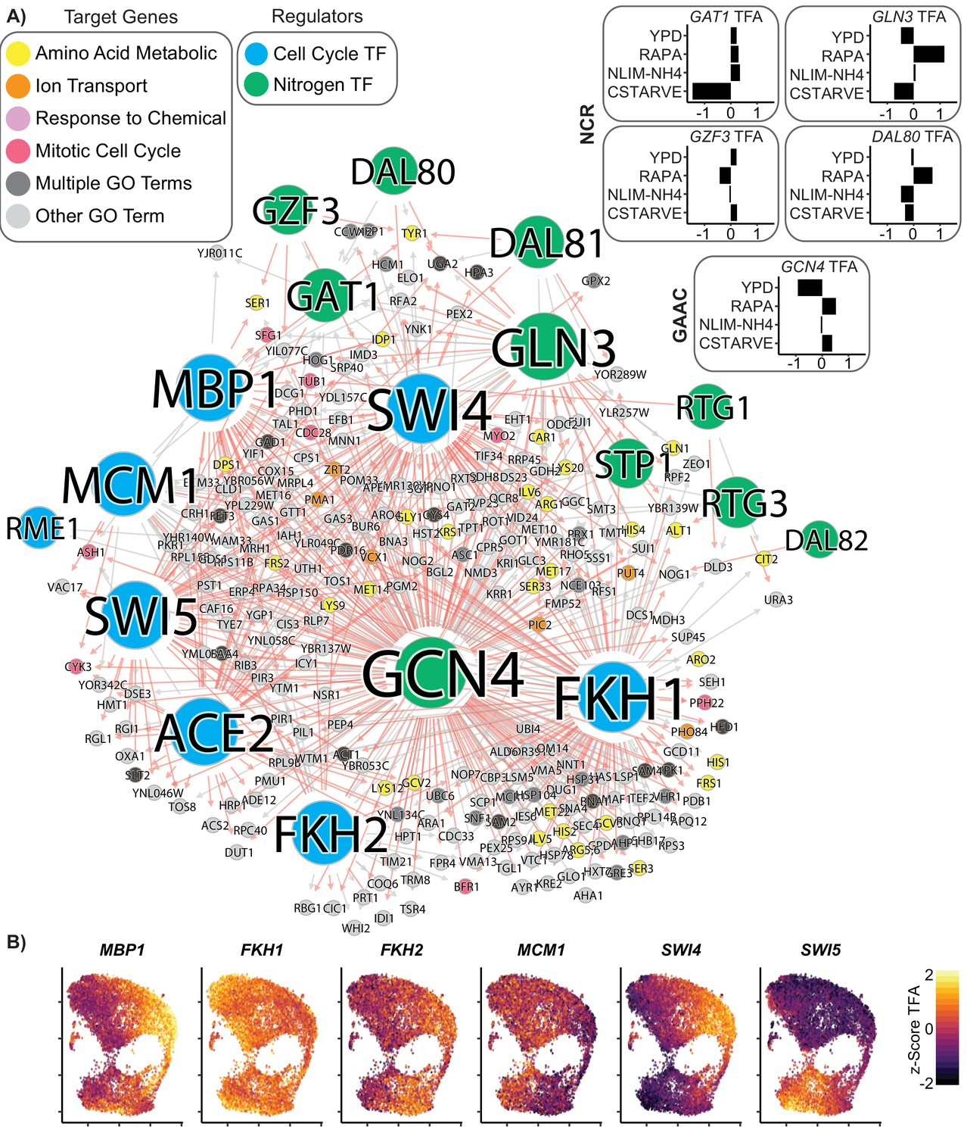
Gene Regulatory Network (GRN) analysis
GRNs can be inferred from RNA-seq data to understand the complex interactions between genes and identify key transcriptional regulators
Several different approaches for GRN inference
Correlation-based approaches (such as Pearson or Spearman correlation)
Mutual information based approaches, which can capture both linear and nonlinear relationships between genes (e.g. ARACNE)
Machine learning algorithms like GENIE3 which use random forests to infer GRNs
GRNs can be perturbed in diseases. Inferring GRNs from perturbation data can help identify key regulators (transcription factors) and pathways involved in disease progression.
https://doi.org/10.7554/eLife.51254

Slide 19
Practical session
https://github.com/BioinfoHKUSurgery/Bioinfo-Workshop-2024

